Slide 1


Slide 2

Tutorial 1
Sections 009/010
TA: Greydon Gilmore
Physiology 2130
Sept 12th, 2017

Slide 3
Today
Course Review and Tutorial Details
Study Tips

Slide 4
Ice Breaker
Name
Department
Where you are from
Write any trepidations you have about this course
Anything that is worrying you right now about the course

Slide 5
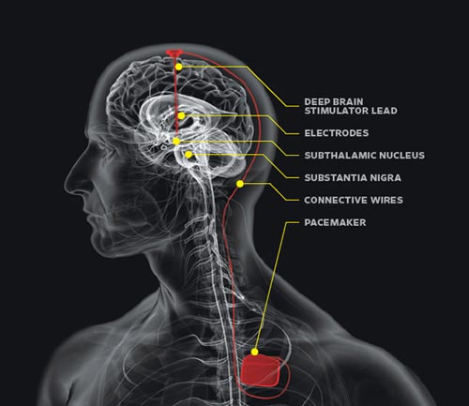
Deep Brain Stimulation

Slide 6
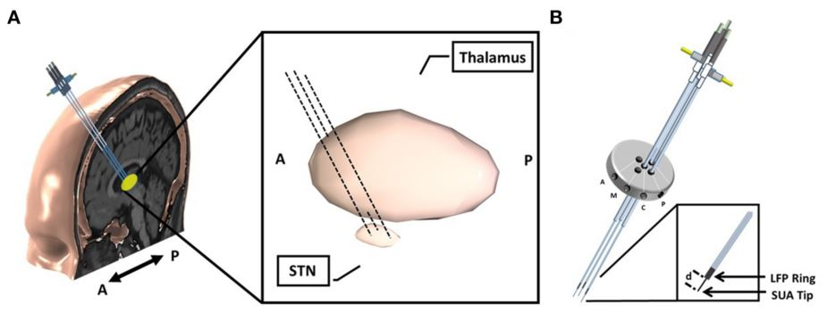
Deep Brain Stimulation

Slide 7
Course Breakdown
6 Assignments (6%)
4 Quizzes (4%)
Midterm 1 (15%)
Friday Nov 10th at 6:00pm (1 hour), 30-35 multiple choice questions
Midterm 2 (15%)
December Exam Period (Dec 10th – 21st) (1 hour), 30-35 multiple choice questions
Midterm 3 (15%)
Friday March 2nd at 6:00pm (1 hour), 30-35 multiple choice questions
Final Exam (40%)
April Exam Period (April 14th – 30th) (3 hours)
75-80 multiple choice questions (CUMULATIVE, focus on last quarter)
Tutorials Attendance and learning catalytic questions (5%)
22 tutorial sessions

Slide 8
Contact
Office: University Hospital, Room BLL-250
Phone: 519-685-8500 ext 76708
Email: greydon.gilmore@gmail.com

Slide 9
Tutorial FAQs
Bring your workbook to complete skipped exercises
Both lecture and tutorial questions can be asked in the forums
E-mail (greydon.gilmore@gmail.com) if necessary with course code (Phys 2130) in subject area
All questions (forums/e-mail) will be responded to within 48 hours
Attendance:
Sign in every week for marks!
May attend different tutorial if needed
Contact Dr. Woods (awall4@uwo.ca) with valid excuse/documentation if you can’t make any tutorial

Slide 10
Success in Phys 2130
Go to every class
Take notes
Plan your time
Class is early so get to bed at a decent time
Don’t procrastinate
Make friends in the class

Slide 11
Studying Tips
Lower Quality
Highlighting everything
Reading notes over and over
Write out notes over and over
Taking too much time making your notes “beautiful”
Higher Quality
Recall lecture note material without your notes
Review material right after class
Study frequently in short time periods
Teach your friends or parents a concept

Slide 12
Learning Catalytic Question
Login to Learning Catalytics
www.pearsonmylabandmastering.com

Slide 13
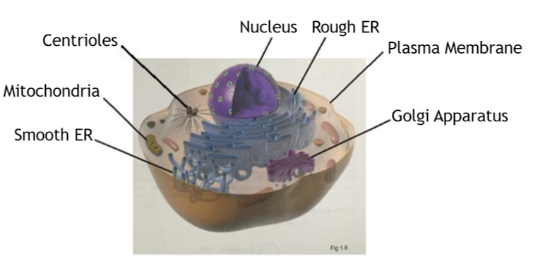
The Cell: Overview of Structures/Organelles (p.9)
Lysosome
Cytoskeleton

Slide 14
Functions of organelles
Centrioles
Aid in cell division, in animals, by formation of spindle fibers that separate chromosomes during mitosis
Mitochondria
Supply the cell with energy in the form of ATP
Nucleus
Contains majority of cells genetic material
Plasma Membrane
Protect the cell from its surroundings
Composed of a phospholipid bilayer with embedded proteins

Slide 15
Functions of organelles
Smooth Endoplasmic Reticulum
Manufacturing of lipid (fat) molecules
Rough Endoplasmic Reticulum
Rough due to ribosomes being dispersed throughout the membrane to help in the production, folding and transportation of proteins
Golgi Apparatus
Modify, sort and pack macromolecules (mostly proteins coming from the Rough ER)

Slide 16
Functions of organelles
Lysosome
Houses enzymes for digestion and waste removal
Cytoskeleton
Composed filaments and tubules, extending from plasma membrane to nucleus
Provides the cell shape and protects it from damage

Slide 17
Next Week
Excitable Cell 1 (Sept 7th)
Homeostasis and Body Fluid Compartments
Excitable Cell 2 (Sept 12th)
The Interaction of the Cell with its Environment

Slide 18
Questions?
You can ask in the forums as well!!

